Slide 1



Slide 2
Batch fire against Graph API
Uzejnovic Ahmed

Slide 3
01
05
Introduction.
Batching process limits.
02
06
Graph API Workflow
Demo.
03
Batching with Graph.
04
Batching advantages.

Slide 4





LastName : Uzejnovic Ahmed
FirstName : Ahmed
Job : IT Automation Consultant @au2mator
Facts : PowerShell & Bikepacking From : Austria
Github : https://github.com/uzejnovicahmed Blog : https://powershell.works

Slide 5
Graph API functionality

Slide 6
Request Access token
Magic …. .. .. .. ..
Access token
HTTP Request (GET,POST,DELETE,….) + Access token
Magic …. … .. .. .. ….
HTTP response

Slide 7
Batching with the Microsoft Graph API

Slide 8
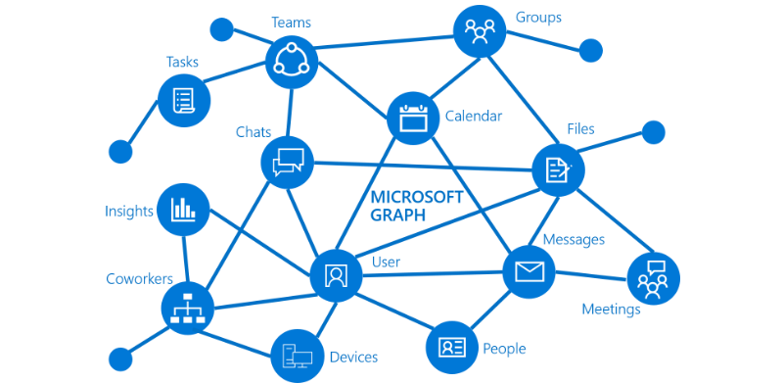
Batch fire against Graph API
Request 1
Request 2
Request X

Slide 9
Request processed by the Graph API
requests :
[
{
id : 1 ,
method : GET,
url : /me/drive/root:/{file}:/content
},
{
id : 2,
method : PATCH ,
url : /me ,
body : { city : Hannover },
headers : { Content-Type : application/json }
}
]
HTTP Request POST + JSONBODY + Access token
responses :
[
{
Id : 1,
Status : statuscode
},
{
Id : 2 Status : statuscode
body : {responsebody}
}
]
Response

Slide 10
The advantages when Batching is used

Slide 11
lesser network traffice
Faster script execution
Specification of dependencies
Saving money

Slide 12
Batching Limits

Slide 13
20 Requests per Batch
Servicespecific throttling limits
No way to catch the result in a batch and use it in the same batch

